Slide 1
Beer Accessibility in Calgary, ab
Coursera Capstone Project
Notes:
© Copyright PresentationGo.com – The free PowerPoint library

Slide 2
Beer Accessibility in Calgary – Introduction
In 1993, there were only 202 Liquor Stores in the entire province.
In 1993, following a provincial election, all ALCB liquor stores were quickly privatized and the industry experienced a major boom.
The decision was controversial, due to its impact on both employment and alcohol availability.
The objective of this Capstone Project is to explore Calgary communities to establish how available beer is in Calgary today, both in retail venues and in restaurants.
Information available from public sources will be collected and analysis of Calgary communities performed.
It is expected, that the downtown and University of Calgary areas are best-served in this respect, while bedroom communities in the suburbs are not.
Notes:
© Copyright PresentationGo.com – The free PowerPoint library

Slide 3
Data Section
Data Link: https://data.calgary.ca/Business-and-Economic-Activity/Calgary-Business-Licences/vdjc-pybd/data - the link has been obtained from City of Calgary pages and contains the list of all businesses legally operating in the City.
The dataset contains data about all relevant establishments in all communities of Calgary.
For the purpose of this exercise, the selected dataset is deemed to serve the purpose best, as it can be relied on to contain an exhaustive list of relevant entities.
Following review of the data and some pre-processing, the relevant data has been mapped out to obtain an overall perspective on beer availability in the City.
Initial data obtained from the Business License Register included the following information: 1. Tradename , 2. Address , 3. License Type, 4. Community, 5. Status, 6. Date of Registration, 7. Address Longitude, 8. Address Latitude
Finally, a map was obtained from Folium Maps.

Slide 4
Methodology and Results Sections
To analyze the data obtained and pre-processed, k-means clustering has been selected as the approach providing the most useful information.
Map of clusters in Calgary.
List of all locations within clusters in Calgary
Ranking of the Clusters
Additional information on the Province of Alberta and City of Calgary
Calgary Business Licenses: This Capstone project uses the City of Calgary dataset collection as its prime data gathering source as it contains data on all legally operating businesses in the City and includes the licensed businesses in the City of Calgary.

Slide 5
Discussion and Conclusion Sections
The objective of this project is to illustrate the impact on the society of changing the rules and provide basic information on the current situation. As mentioned previously, until 1994, there were only 202 liquor stores in the entire province.
The numbers show clearly that, deregulation of the industry has led to a boom - there are over 350 liquor stores in Calgary and the number of beer-serving places has gone well over 1,500.
In this Capstone project k-means clustering was used to divide the City of Calgary into 8 clusters. The number of entities in clusters varies from 103 to 756 venues.
The findings support the assumption that downtown houses the largest number of beer-serving establishments, while the bedroom communities in suburbs have the lowest number of the venues.
This Capstone Project could be used to develop a beer map of Calgary with more focus on quality aspect.
Libraries used:
Pandas: To create and manipulate dataframes.
Folium: To visualize the venues and cluster distribution of using interactive leaflet map.
Scikit Learn: To import k-means clustering.
JSON: To handle JSON files.
Geocoder: To retrieve Location Data.
Beautiful Soup and Requests: To scrap and library to handle http requests.
Matplotlib: To plot data.

Slide 6
Calgary Business License Register Example
First, the dataset of all valid Calgary business licenses is uploaded and column titles adjusted.
In [1564]:
YYC_biz_df = pd.read_csv('https://raw.githubusercontent.com/jantyl56A/Coursera_Capstone/master/Calgary_Business_Licenses_Map.csv', sep=',', index_col=None) #YYC_biz_df.columns YYC_biz_df.head()
Out[1564]:
 | TRADENAME | ADDRESS | LICENCETYPES | COMDISTNM | JOBSTATUSDESC | JOBCREATED | longitude | latitude
0 | POLAR WINDOW OF CANADA | #103 3953 112 AV SE | RETAIL DEALER - PREMISES | EAST SHEPARD INDUSTRIAL | Pending Renewal | 09/30/2013 12:00:00 AM | -113.980378 | 50.952254
1 | JARVIS INTERIOR | 4615 8A ST NE | CONTRACTOR | GREENVIEW INDUSTRIAL PARK | Pending Renewal | 01/24/1995 12:00:00 AM | -114.042752 | 51.092998
2 | WESTLAND APARTMENTS | 4231 BOW TR SW | APARTMENT BUILDING OPERATOR (1 TO 3 STOREYS) | ROSSCARROCK | Renewal Licensed | 01/05/1998 12:00:00 AM | -114.148705 | 51.047190
3 | RICKY'S ALL DAY GRILL | #1668 1632 14 AV NW | ALCOHOL BEVERAGE SALES (DRINKING EST/RESTAURANT) | HOUNSFIELD HEIGHTS/BRIAR HILL | Renewal Licensed | 09/03/2010 12:00:00 AM | -114.099809 | 51.065921
4 | BLOWERS & GRAFTON | 2120 4 ST SW | FOOD SERVICE - PREMISES (SEATING) | MISSION | Licensed | 07/10/2020 12:00:00 AM | -114.071253 | 51.033575

Slide 7
Liquor Store, Restaurants, Bars and Pubs Register Example
 | Tradename | Address | License Type | Community | Status | Established | Longitude | Latitude
31 | ZYN THE WINE MARKET | #100 1543 17 AV SE | LIQUOR STORE | ALYTH/BONNYBROOK | Pending Renewal | 11/03/2008 12:00:00 AM | -114.027838 | 51.036524
40 | CELLAR (THE) | #100 137 8 AV SW | LIQUOR STORE | DOWNTOWN COMMERCIAL CORE | Pending Renewal | 11/14/2001 12:00:00 AM | -114.065148 | 51.045335
65 | SOBEYS SPIRITS WINE COLD BEER CRANSTON | #4010 356 CRANSTON RD SE | LIQUOR STORE | CRANSTON | Renewal Licensed | 06/19/2009 12:00:00 AM | -113.976173 | 50.880257
188 | SOMERSET LIQUOR STORE | 16329 SOMERCREST ST SW | LIQUOR STORE | SOMERSET | Renewal Licensed | 07/09/2004 12:00:00 AM | -114.090439 | 50.903410
212 | BSW LIQUOR AVIATION | #134 425 AVIATION RD NE | LIQUOR STORE | CALGARY INTERNATIONAL AIRPORT | Pending Renewal | 10/15/2019 12:00:00 AM | -114.030416 | 51.096781

Slide 8
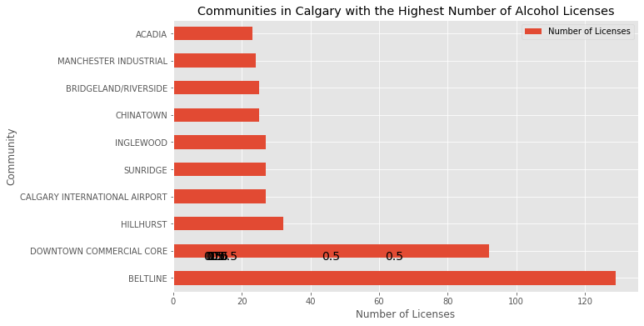
Ten Communities with the Highest Number of Licenses

Slide 9
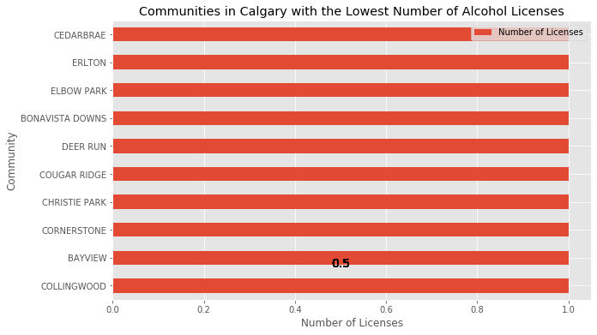
Ten Communities with the Lowest Number of Licenses

Slide 10
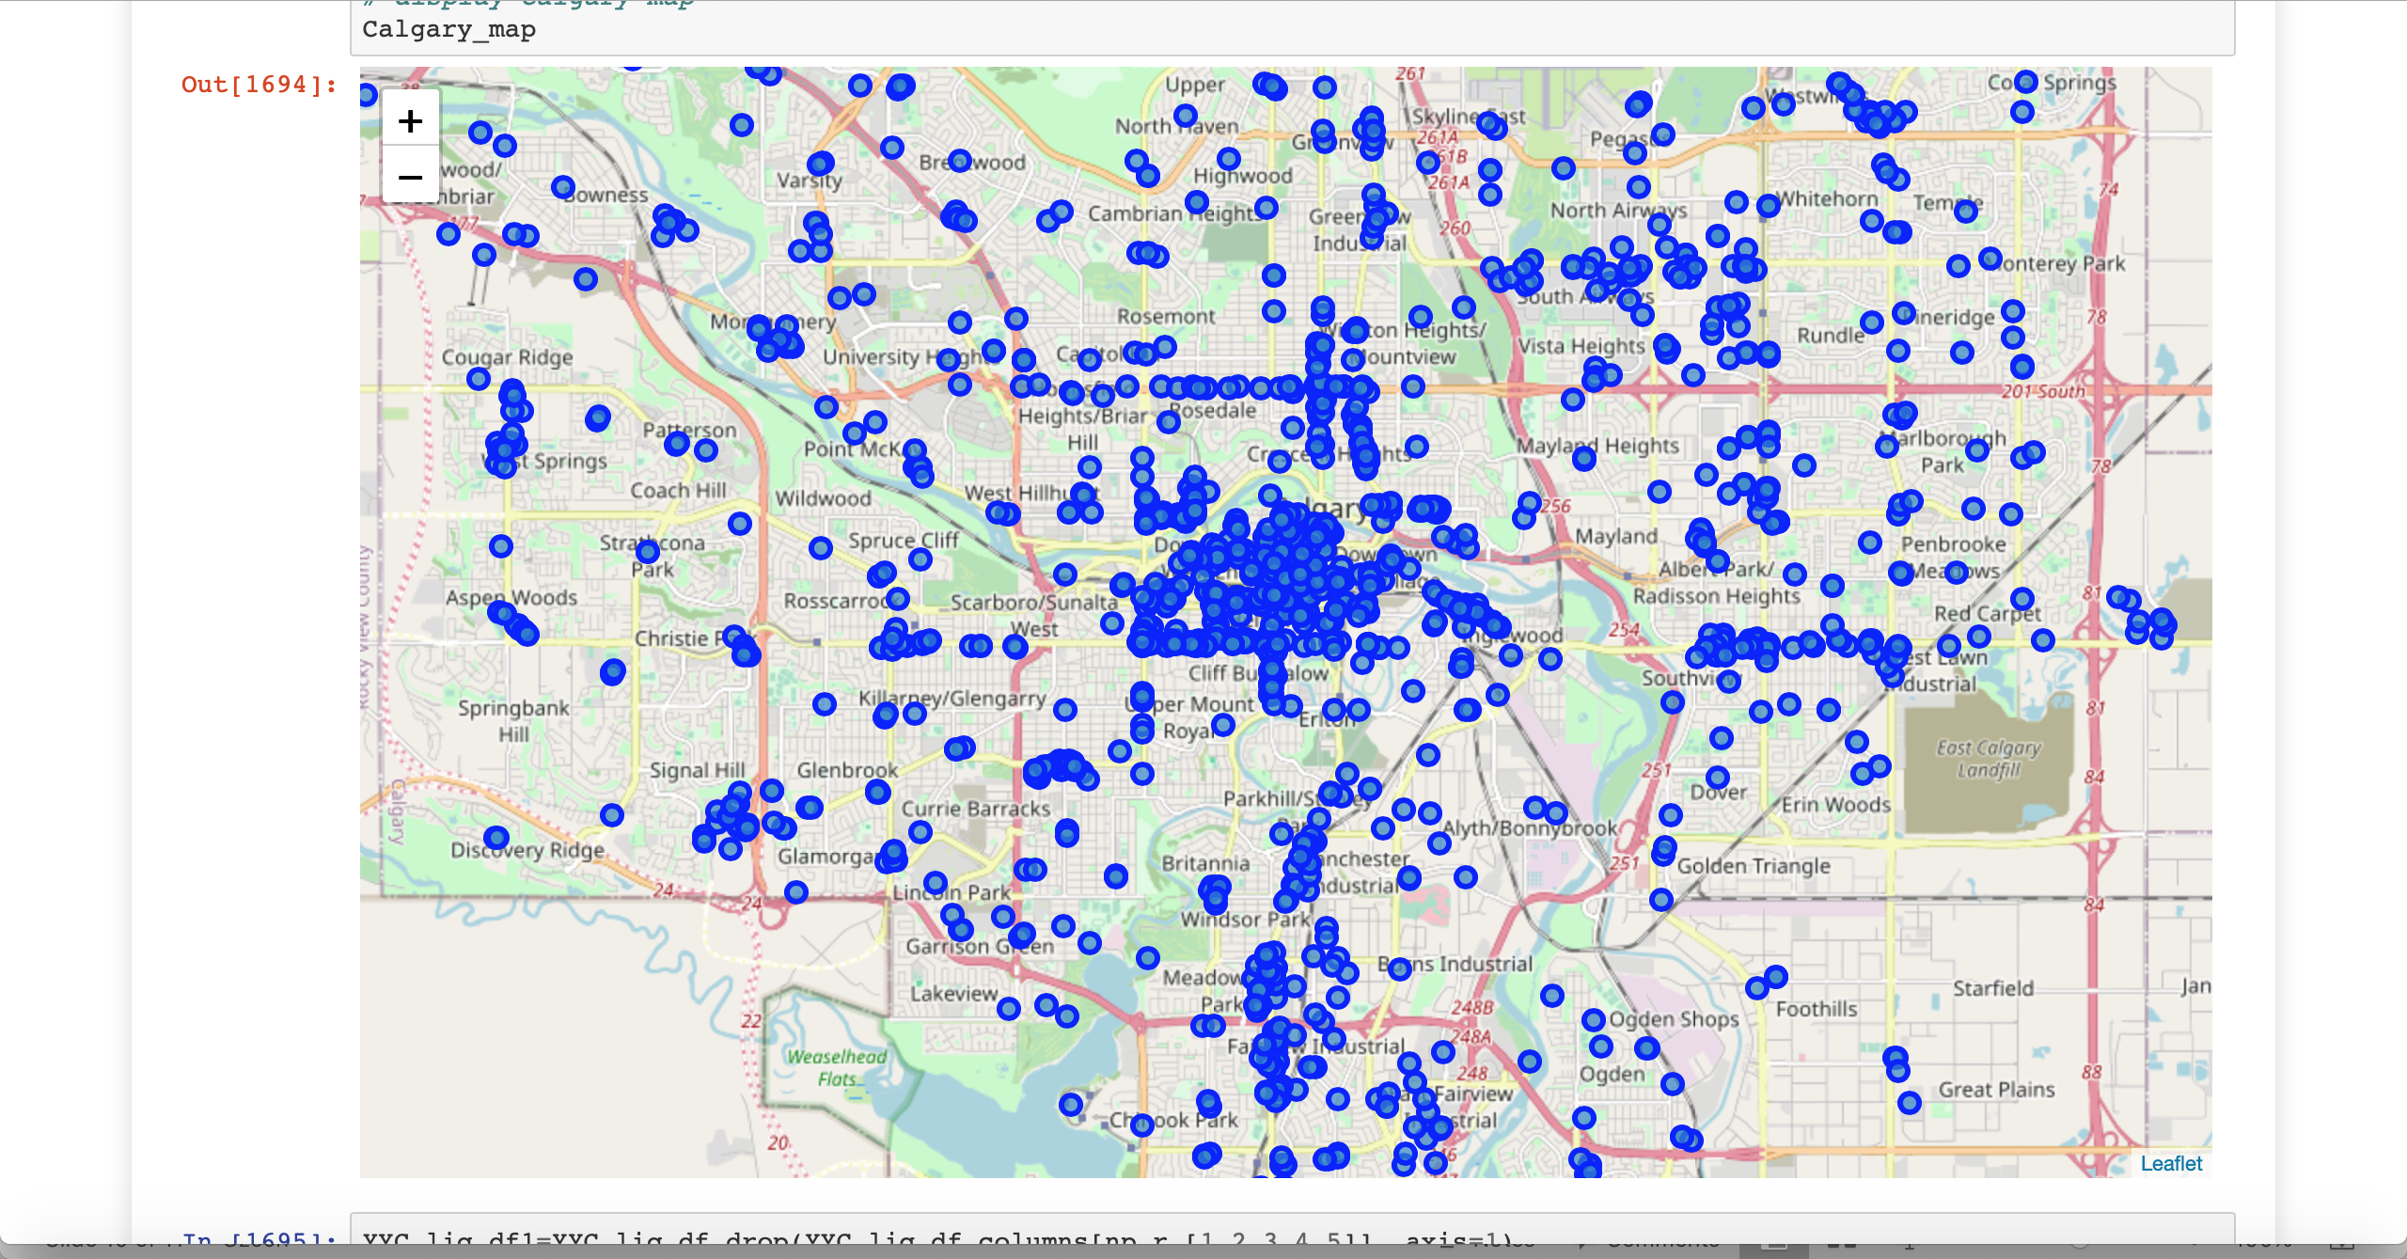
Map of Calgary – All Venues

Slide 11
Venues Clustering

Slide 12
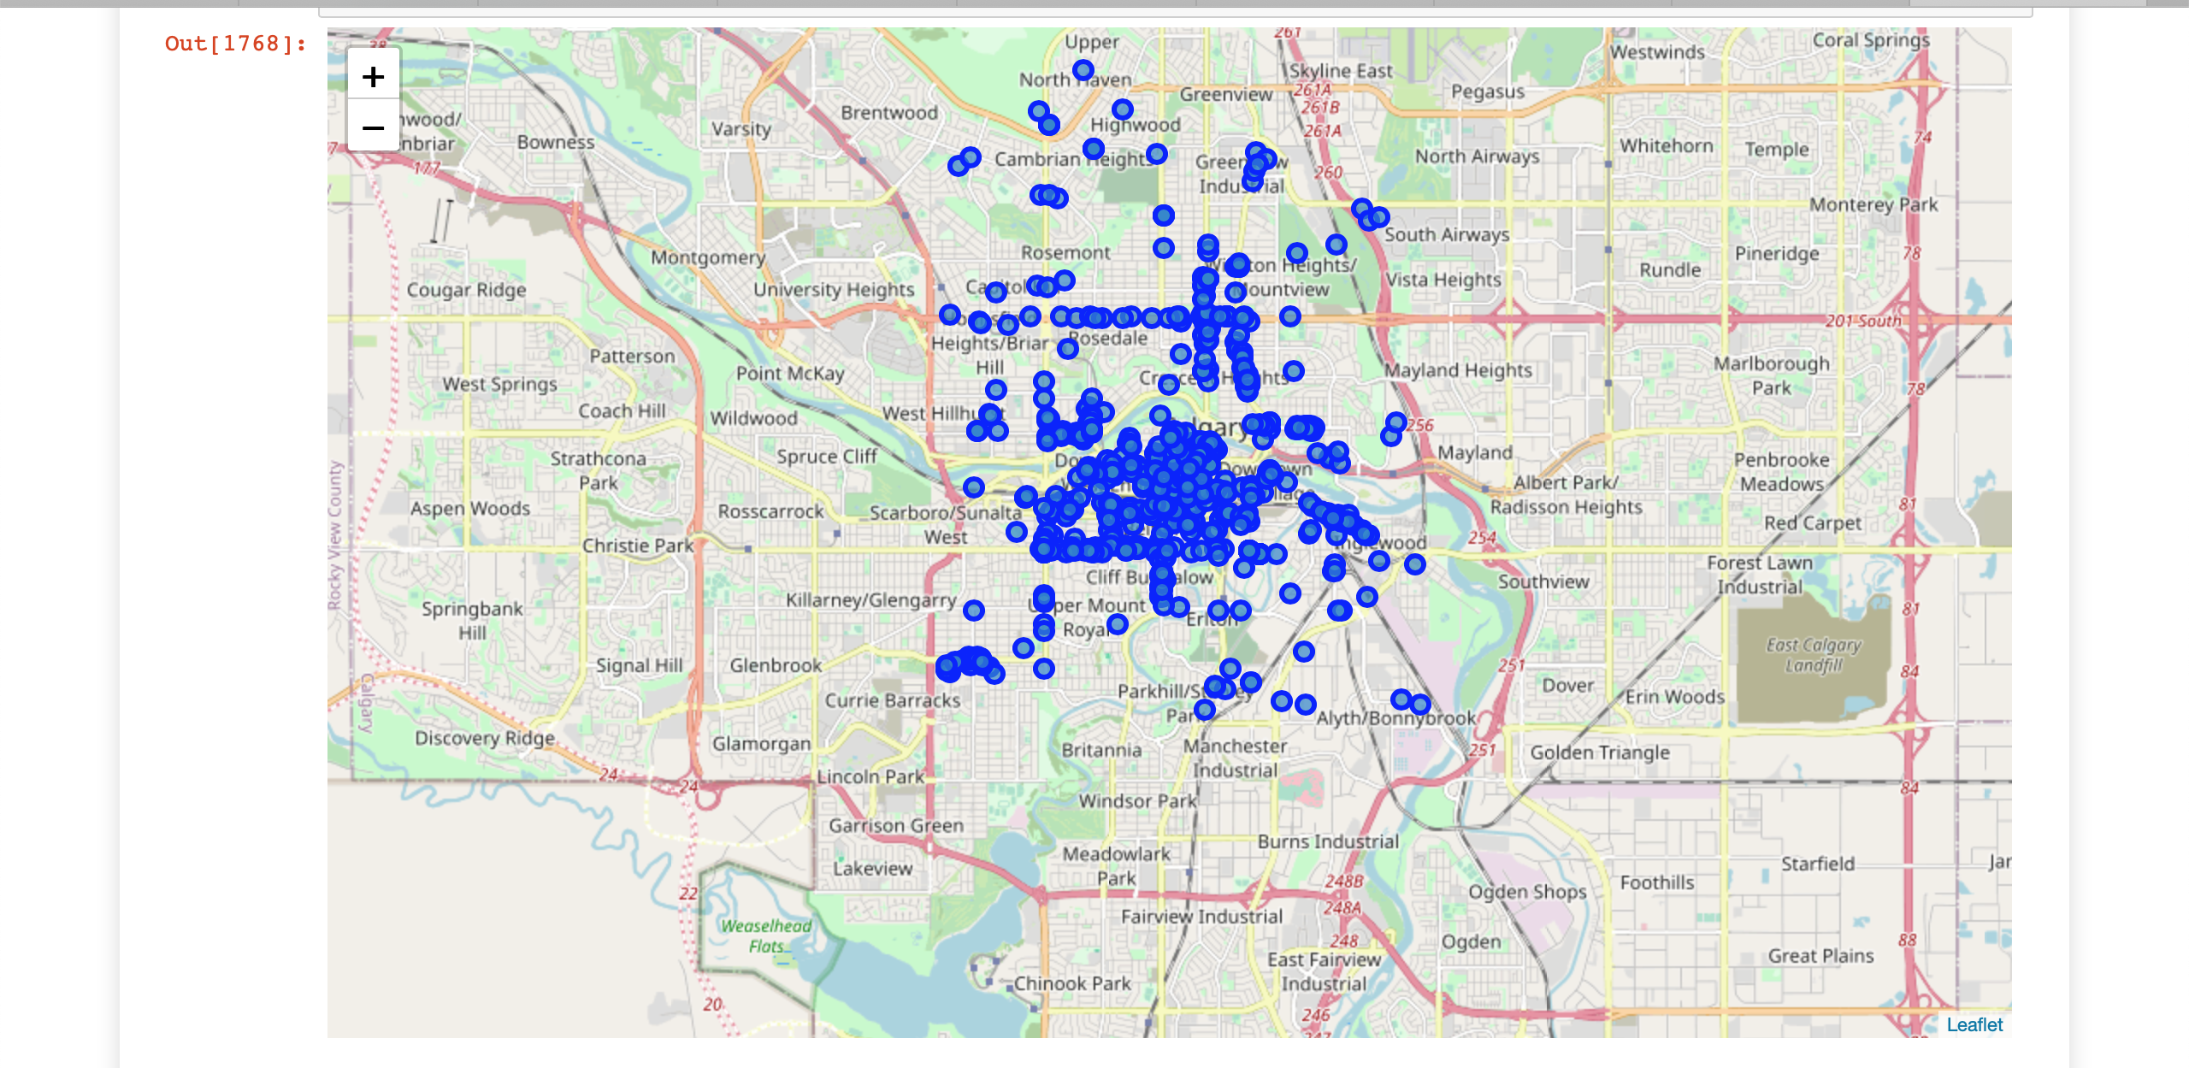
Cluster 5 – Highest Number of Venues

Slide 13
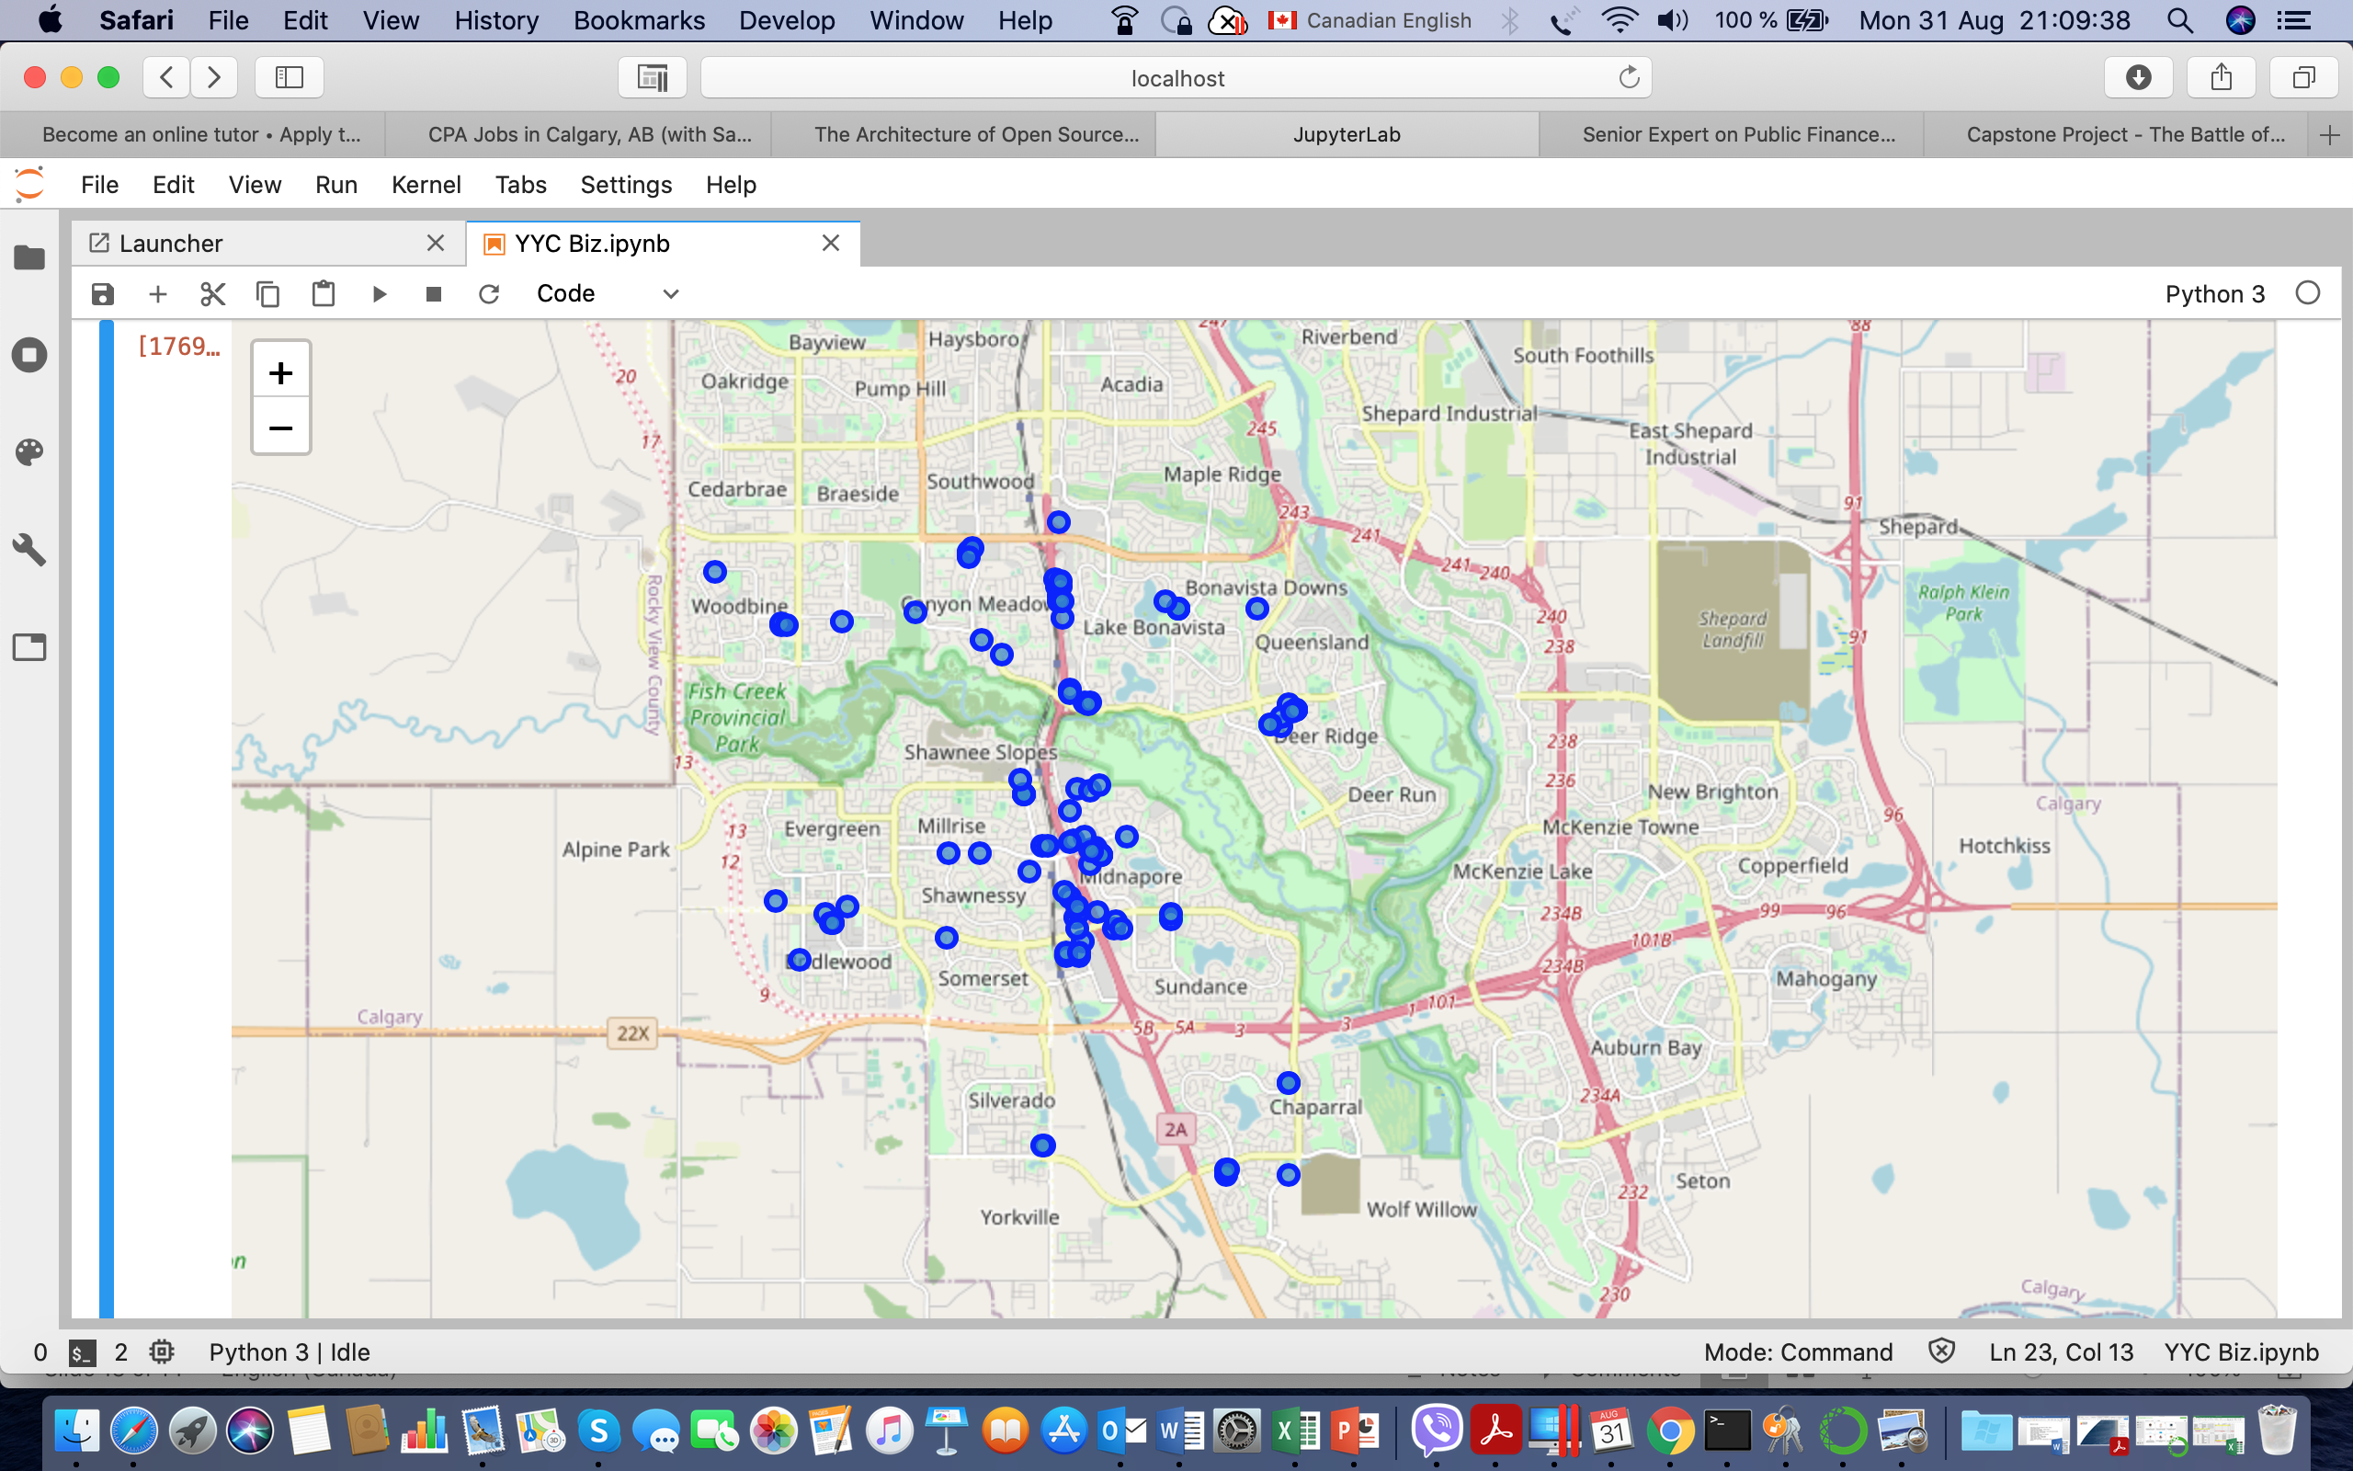
Cluster 3 - the Lowest Number of Venues

Slide 14
Conclusion
The results show that, as expected, the largest concentration of liquor stores, restaurants, bars and pubs is in downtown Calgary.
The lowest concentration of the venues is in South East Calgary.
The results do show, however, that, since the privatization of the industry in 1994, there has been a significant increase in the number of venues selling alcohol.

Slide 15
Notes:
© Copyright PresentationGo.com – The free PowerPoint library

